Slide 1
Research presentation 2006 - present
Rebeca Gonzalez Suarez

Slide 2


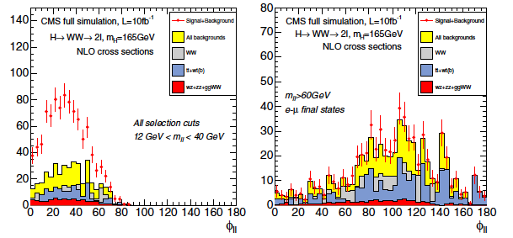
September 1st 2006
Start of “FPI” PhD grant with University of Oviedo-IFCA, joined CMS
Before that date:
Obtained Physics degree in June 2005 (Universidad de Oviedo)
Joined the HEP Oviedo group right after
The starting point of my PhD studies was the Higgs to WW section of the TDR
Right after the TDR was done, I took over the Higgs to WW with two muons and two neutrinos in the final state
The CMS Collaboration 2007 J. Phys. G: Nucl. Part. Phys. 34 995 doi:10.1088/0954-3899/34/6/S01

Slide 3
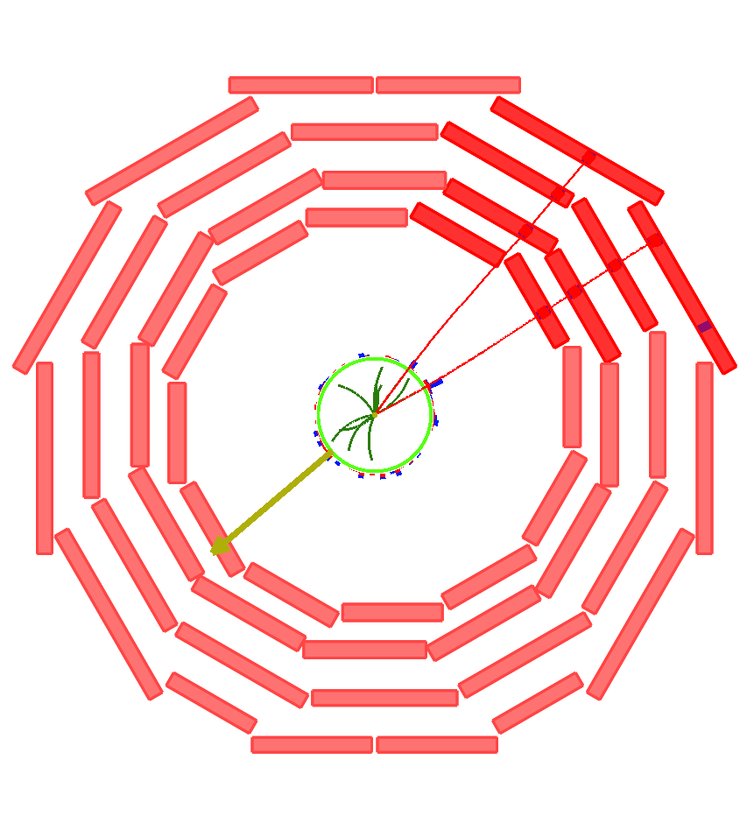
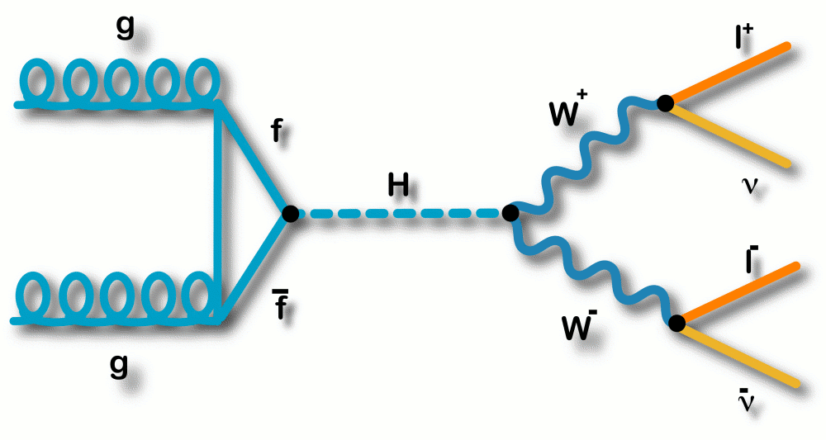
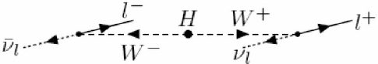
SM H → WW* → 2µ2ν
H → WW* → 2l2ν, discovery channel for a SM Higgs boson in a wide mass range in the LHC
Branching ratio close to 1 in 2m_{W} < m_{H} < 2m_{Z}
Clear experimental signature:
2 high P_{T} leptons with opposite charge and a small transverse opening angle (spin correlations)
Missing ET
No jets (gluon fusion)
Backgrounds:
Real or fake multi-lepton final states + missing ET:
‘irreducible’ WW (WZ, ZZ),
ttbar (tW),
Drell-yan, W+jets…

Slide 4
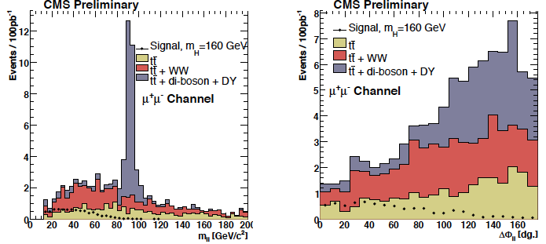
First contributions
14 TeV studies in Monte Carlo
Study of the variables
Mass-dependent optimization of the cuts:
low:(120, 130, 140) intermediate (150, 160, 170) and high (180, 190, 200)
First estimations of ttbar background (b-tagging)
PAS HIG-07-001
First Higgs PAS in which I participated
14 TeV, 100pb⁻¹
m_{H} = 160 GeV

Slide 5
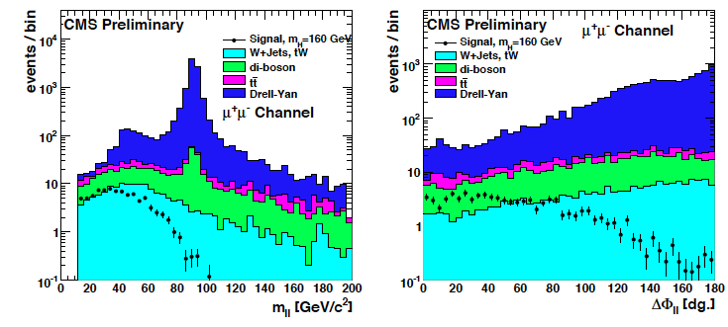
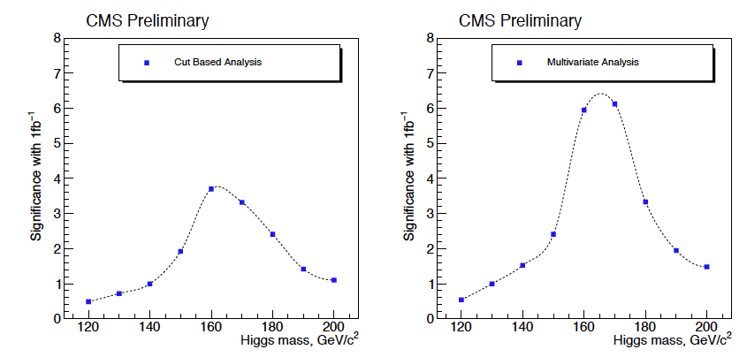
HIG-08-006
Next public analysis, before the start of the data-taking:
14 TeV, 1fb⁻¹
Mass dependent cuts, first multivariate analysis proposed
Control regions for WW and tt and first fake lepton studies
Prospective estimations of lepton and trigger efficiencies and systematic uncertainties
First significance estimations

Slide 6
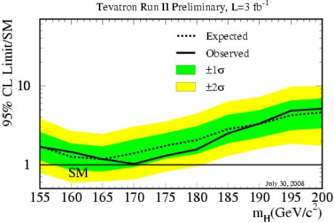
2008: Tevatron exclusion LHC incident
In ICHEP2008, around one month before the startup of the LHC, the Tevatron experiments announce the exclusion of SM Higgs with m_{H} ~170GeV, close to our (then) favorite mass, 160GeV
(This was the first plot of many that followed)
In September, the LHC starts operation, to be stopped 9 days later after an incident.
The LHC plans are altered in a big way, it means not only a large delay, but also a change in the running conditions.
The center of mass energy of the collisions will no more be 14TeV, but lower. Several scenarios are considered (initially 6 or 10 TeV)

Slide 7
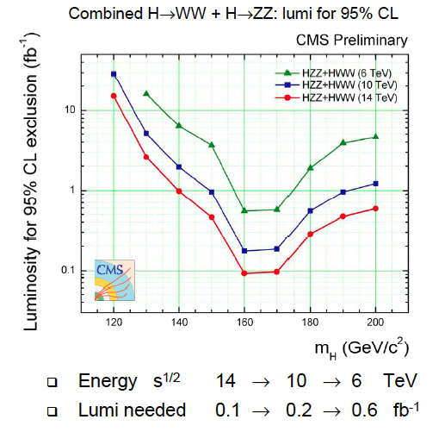
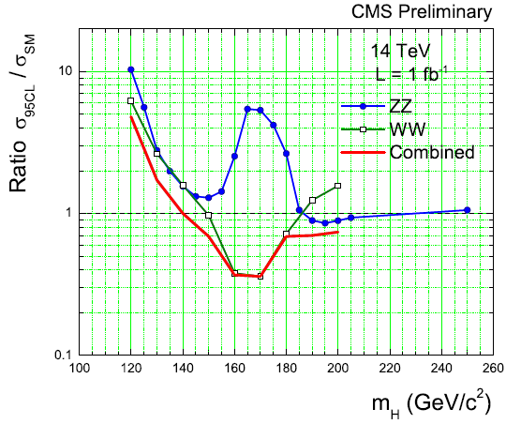
2009: Chamonix and 10 TeV
We react rapidly by preparing 14 to 10 and 6 TeV estimations, by scaling using the cross-section ratios and fast simulation
A reduced group of people working tirelessly during Christmas 2008/Early 2009 to produce public estimations for Chamonix 2009 (February)
CMS AN-2009/020
10 TeV is considered the most likely scenario, Monte Carlo samples are prepared and the full analysis is carried out (never made public, CMS AN 2009/139)

Slide 8
2010: data @ 7 TeV
November 2009: Beams circulating again
January 2010: Chamonix, decision to run at 7 TeV (bye, bye 10 TeV studies)
February 2010: First theoretical estimations of cross-section and branching ratios for all the SM Higgs channels at 7 TeV
Fabian Stöckli and Rebeca Gonzalez Suarez, for the CMS Higgs Working-Group, “SM Higgs Production Cross-Section and Branching-Ratios at 10 TeV and 7 TeV” http://wwweth.cern.ch/HiggsCrossSections/ (obsolete)
March 2010: Collisions at 7 TeV
May 2010: Estimations of the Higgs potential at 7 TeV (from scaled 14 TeV results) made public (we also prepared estimations at 8 TeV, plots are public)
7 TeV Monte Carlo ready, full analysis ready to perform (nothing public)

Slide 9
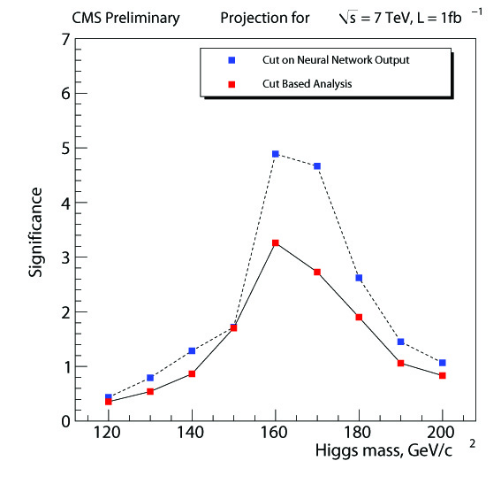
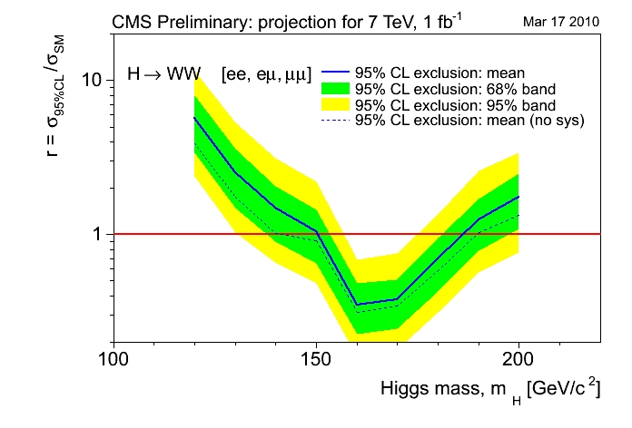
HWW projections @ 7TeV
CMS AN 2010/008 - 'The CMS physics reach for searches at 7 TeV'
(CMS Collaboration) http://cdsweb.cern.ch/record/1264099/
7 TeV, ∫Ldt = 1fb⁻¹ (projection)
Exclusion 95%CL: 150<m_{H}<185 GeV
Discovery level sensitivity (~5σ) : 160<m_{H}<170 GeV

Slide 10
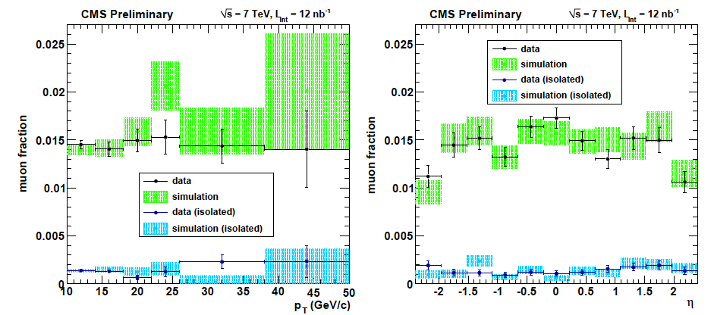
Work with early data
Study of tracks faking muons with 12nb⁻¹ (a part of the lepton fake rates studies made for Higgs to WW), appearing in the first muon public results with proton-proton collision data of CMS (MUO-10-002), presented in ICHEP 2010 (summer)

Slide 11
In parallel during my PhD
Service work: Software alignment of the DT chambers
“A Software and Computing prototype for CMS Muon System alignment”, (Iban Cabrillo, Isidro Gonzalez Caballero, Rebeca Gonzalez Suarez...), Journal of Physics: Conference Series 119 (2008) 072008
Higgs to WW BDT analysis: Gave the starting code for the implementation of BDT analysis in the HWW to 2µ2ν channel. Starting from the same pre-selection, I contributed sharing and updating code.
Helped in the analysis to measure the W charge asymmetry (CMS AN-2008/074) and in the tt dilepton (CMS AN2010/406)
WW cross-section measurement: set-up the starting analysis and proposed within my group to measure it together with HWW (CMS AN-2009/025, CMS AN-2009/185)

Slide 12
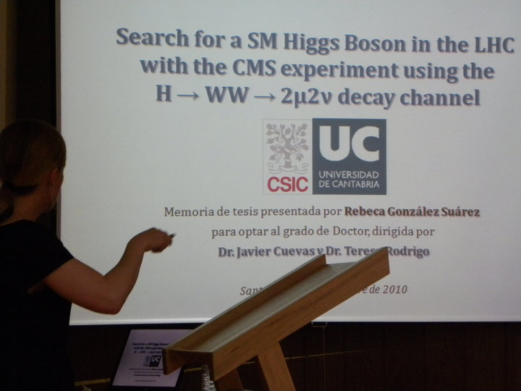
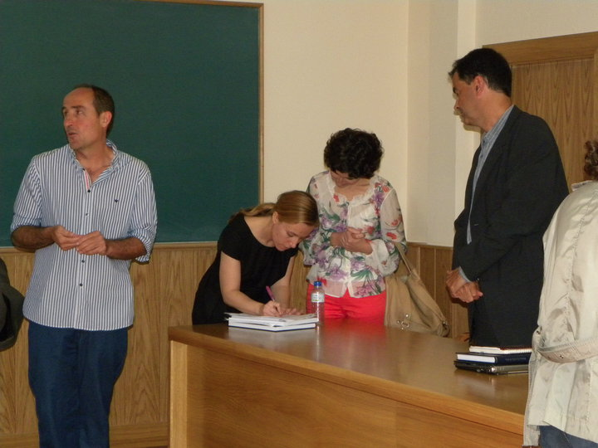
9 September 2010
Defense of PhD thesis:
“Search for a SM Higgs Boson in the LHC with the CMS experiment using the H → WW∗ → 2μ2ν decay channel”
http://cdsweb.cern.ch/record/1296019/
Dir. Javier Cuevas (Universidad de Oviedo) and Teresa Rodrigo (IFCA)
Sobresaliente Cum Laude

Slide 13

November 1st: Joined the VUB
In November 2010 I joined the Vrije Universiteit Brussel (VUB) as a postdoc, in the group of Jorgen D’Hondt with Freya Blekman as supervisor
I moved to top physics, in which the group has an important presence, starting by contributing to the e+jets cross-section analysis:
”Measurement of the tt Production Cross Section in pp Collisions at 7 TeV in Lepton + Jets Events Using b-quark Jet Identication”, CMS Collaboration (Serguei Chatrchyan et al.), Phys.Rev. D84 (2011) 092004, arXiv:1108.3773
Following that, I started my own analysis, studying the single top tW associated production:
Nobody was working on it
Process still to be observed (not accessible at the Tevatron)
Only one rough early study made by CMS for the TDR (2006)
ATLAS already had results with data and a team formed
Very similar to HWW
Signature could be exploited to do BSM searches, 4th generation, EWK measures of top quarks

Slide 14
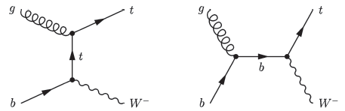
tW dilepton topology
tW leptonic final states (ee/eµ/µµ) studied
Main sources of background:
ttbar (dominant background, irreducible, mixes at NLO)
Z+jets (large cross section, always dangerous)
Also di-boson production (WW, WZ, ZZ), and negligible contributions from W+jets,
other single top processes (t and s channel) and QCD
Signal signature:
2 opposite sign, isolated leptons (e or µ)
Missing E_{T} (2 neutrinos)
1 jet (coming from a b-decay)
Similar channel
Higgs to WW + 1jet
The small cross section of tW signal (15.7pb@7TeV, 22.2pb@8TeV), complicates the search

Slide 15
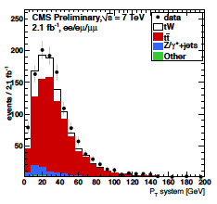
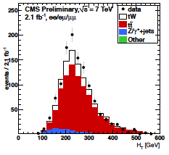
PAS TOP – 11 – 022
Working from scratch I prepared the analysis in Monte Carlo and applied it to 2011 data (2.1fb⁻¹ for the summer result, August 2011)
Simple cut-based approach applying a couple of extra kinematic cuts on events with two leptons, 1 b-tag jet and Missing E_{T}
After b-tagging only tt (70%), a little Z+jets component, and tW signal (20%) remain
Z+jets estimated in/out Z mass window; tt background is complicated and requires the use of two control regions (2jets 1b-tag, 2jets 2b-tags)
CMS AN-2011/465

Slide 16
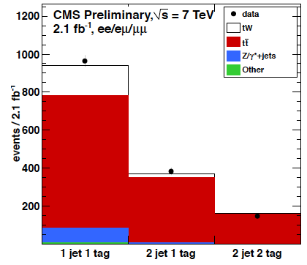
Summer result (2011)
Observed significance: 2.7σ
Expected significance: 1.8±0.9σ
Cross section value: 22+9-7 (stat+syst) pb
(PAS TOP-11-022, manpower and editor)
Working alone I got a better result than ATLAS with higher sensitivity
(by then, ATLAS had 1.2σ)
Result obtained using 9 final states ( ee/eµ/µµ in signal and two tt control regions), multichannel statistical treatment (Higgs-like, KIT framework “theta” by Jochen Ott)
One of the highlights of TOP2011, the results appeared in many places after being made public (conferences, summary talks of CMS results, and the CERN courier –October 25-)

Slide 17
2012: tW paper
People joined the tW effort, I still work in the analysis but I’m also coordinating
~10 people at the moment, 2 new institutions, 2 PhD students to write their thesis about tW, +1 new student ready for 2012 data
Next goal in reach: PRL with CMS’s tW evidence (ATLAS just published the evidence just before ICHEP, 3.3σ) using the full 2011 dataset
Editor of the document
Multivariate analysis (based on a BDT) and cut-based as cross-check
Internal CMS notes:
CMS AN-2011/465
CMS AN-2012/060
+ additional likelihood that was dropped
Paper talk last Thursday:
https://indico.cern.ch/conferenceDisplay.py?confId=201278
4σ observed (3.6σ expected), cross-section, |V_{tb}| also measured
Status in CADI: Ready for CWR
Coming soon!

Slide 18
2012 data
Since the last couple of weeks I’ve been checking the 8 TeV data and adapting the tW code to the new selections
The validation of all the objects that the analysis uses: electrons, muons, jets (b-tagging), and Missing E_{T}, at 8TeV will be the project of my summer student (Isis Van Parijs)
To be presented in Brussels as a bachelor thesis as well
Plans on re-running the analysis at 8 TeV
reach 5σ
study the use of loose jets as discriminant against tW
Maybe extend the analysis to broader goals: BSM or precision measurements
One thesis will come from the paper results in the Fall (Will Patrick Martin from Brunel) and another one will come from the 7 and 8TeV tW analysis (Daniel Noonan, Kansas); a third one is envisioned for 8 TeV only (Duncan Leggart, Brunel)

Slide 19
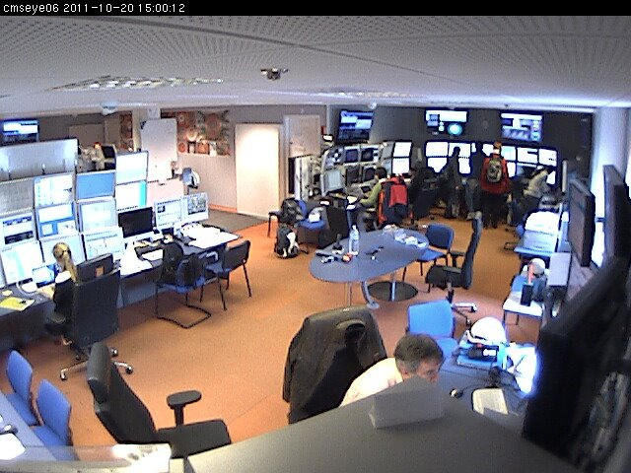
Service work and shifts
Contact person for the local reconstruction of the strips
Several developments of the code:
Automatic Peak-Deconvolution mode switch (before it was made “by hand”)
Removed possible occurrence of a mixed mode
Det Id information removal from the strip clusters
Reading information of FED errors from DQM files
I maintain a shift quota of > 20 points/year (this year for example, 31)
DT offline (2008)
DT online (2008/2009)
DT on call (2009/2010)
Central DCS (2010/2011/2012)
Shift Leader (2012)

Slide 20
ARC activities
Member of different analysis review committees (ARC) since Summer 2011
SUSY analysis: multileptons + MET
SUS-11-019: “Search for Physics Beyond the Standard Model in Z + MET + Jets events at the LHC”
SUS-11-021: “Search for physics beyond the standard model in events with a Z boson, jets and missing transverse energy”
Search for physics beyond the standard model in events with a Z boson, jets, and missing transverse energy in pp collisions at sqrt(s)= 7 TeV, CMS Collaboration (Serguei Chatrchyan et al.), Submitted to Physics Letters B, arXiv:1204.3774
SUS-12-006 (CWR): EWKino paper “Search for electroweak production of charginos and neutralinos using leptonic final states in pp collisions at √s = 7 TeV” (6 supporting notes)
SUS-12-007 (merged with SUS-12-006): WZ, ZZ + MET

Slide 21
Conferences
Poster about Muon alignment sent to CHEP07 (Victoria, Canada)
Presented a poster, ICHEP08 (Philadelphia, United States): "Discovery Potential for the SM Higgs Boson in the H to WW to 2l2 channel at LHC”
Talk on behalf of ATLAS and CMS, PASCOS 2009 (Hamburg, Germany): "EW symmetry breaking at the LHC”
Plenary talk on behalf of ATLAS and CMS, BEACH 2010 (Perugia, Italy): "Higgs Search Prospects at the LHC”
+ Chair of the session "Heavy Flavor Decays and Properties - I"
Invited Plenary talk, II CPAN days (Valencia, Spain): "Higgs and SUSY searches in CMS”
Chair of the poster session of the CMS Physics week in Brussels, 2011
Plenary Talk on behalf of ATLAS and CMS, Moriond 2012 (La Thuile, Italy): "Single Top Production at sqrt(s) = 7TeV”
Invited talk, 4th generation and single-top Workshop 2012 (Leinsweiler, Germany): "tW production at CMS”

Slide 22
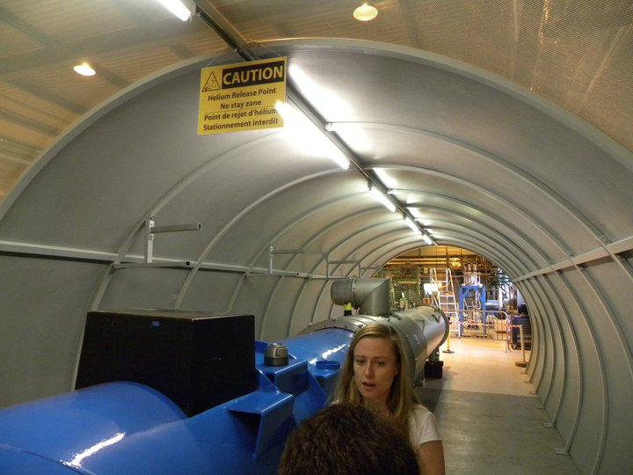
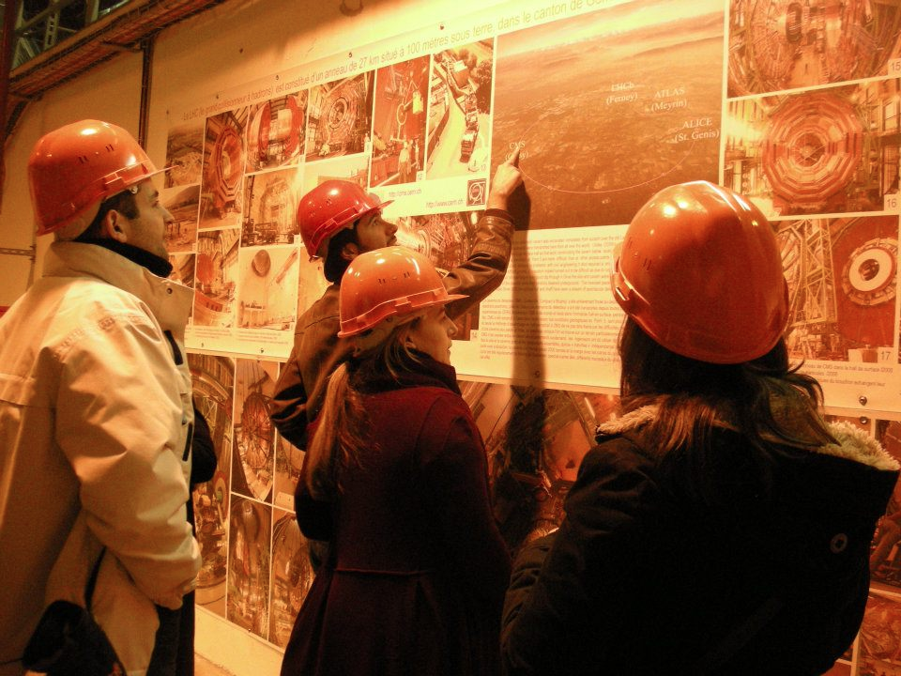
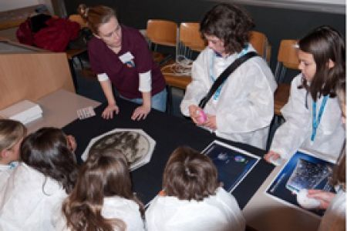
Outreach activities
CERN guide
CMS guide
Meet high school students for Q & A in March 2009 (Doña Jimena High school, Gijón, Spain)
Workshop leader of the "Questions without answers at the LHC" session in the Expanding your horizons (EYH) conference in Geneva, 12th November 2011 coordinating a group of 9 female LHC physicist receiving 3 groups of 45 girls (also from CMS in my session: Claudia Wulz, Bárbara Millán Mejías, María Cepeda) http://cms.web.cern.ch/news/cms-participates-expanding-your-horizons

